Slide 1
Title 1 “Got Funds”
2017-2018

Slide 2
Welcome Title 1 Bookkeepers!
Introductions
Title 1 Support Staff
Dayanara Brooks – Finance (dmbrooks@pasco.k12.fl.us) Ext. 42424
Maddy Wehle – Office of Teaching & Learning (mwehle@pasco.k12.fl.us) Ext. 42324
Michael Gonzalez – Finance (mmgonzal@pasco.k12.fl.us) Ext. 42073
Sharon Trese – Finance (strese@pasco.k12.fl.us) Ext. 42261
New Title 1 bookkeepers
NWES – Amanda Johnson
CENMS – Gail Fisher
CWTES – Tracy Linderman
CES – Juanita Lyerly
HMS – Mona Kohl (Nona Newhouse)
GHS – Kim Stager
PHS – Lisa Plummer
QHES – Shawn Vitale
RBCES – Karen Lamar
SAES – Katrina Stitt
SSES – Veronica Bobala
WES – Sandy Dudley

Slide 3
The Whip-Around
Share one bookkeeping task you love doing.
Share one goal you have for making your job better this year.
Share your favorite way to de-stress or relax.
“Success is no accident. It is hard work, perseverance, learning, studying, sacrifice and most of all, love of what you are doing or learning to do.”
-Pele

Slide 4
What is Title 1?
Federally funded program designed to supplement funds used to assist in meeting student educational goals
Supplement – adding to existing student resources
Supplant – using grant funds to replace funds that would have been provided anyway
Title I funds are meant to be used to help high poverty students meet high academic standards, improve teaching and learning, and increase parent and community involvement.

Slide 5
Managing Title 1 Funds
Using the correct objects and functions
Don’t let objects and functions leave you teetering!
Chart of Accounts 2017-2018

Slide 6
Let your school’s Spending Plan guide you!
Objects
512000 – Classroom Teacher
513000 – Other Certified
515000 – Paraprofessional
516000 – Other Support Personnel
536000 – Rentals & Leases (New all Transportation effective July 1, 2017)
536000 – Chartered Buses (Function 7800)
539000 - Other Purchased Services
539003 – In-House Transportation (Function 7800)
It’s going to be a great year!

Slide 7
Objects
531000 – Professional and Technical Services
531100 - Subawards Under Subagreements First $25,000
531200. – Subawards Under Sub Agreements in Excess of $25,000
539001 - Printing
551000 – Supplies
553000 - Periodicals
559000 – Other Materials
564100 & 564200 - Furniture, Fixtures and Equipment
Only allowed if a new classroom teacher allocation is purchased and a new classroom must be created. Key point, furniture can only be purchased for students or classrooms, not teachers.
575001 – Classroom Substitute
4210.xxxx.xx.31318.575001.5100.0000 (Basic Teacher Planning)
4210.xxxx.xx.31318.575001.5200.0000 (ESE Teacher Planning)
4210.xxxx.xx.31318.575001.6400.0051 (Teachers in PD)

Slide 8
Functions
5100 – Basic K-12
Teacher Lead Funds (4210.xxxx.xx.31318.551000.5100.0054)
Brain Pop (4210.xxxx.xx.31318.536000.5100.0000)
5200 – Exceptional
Teacher Lead Funds (4210.xxxx.xx.31318.551000.5200.0054)
6150 – Parent Involvement
6300 – Instructional & Curriculum Development
Nearpod (4210.xxxx.xx.31318.536000.6300.0000)
“In every day, there are 1,440 minutes. That means we have 1,440 daily opportunities to make a positive impact.”
Les Brown

Slide 9
Functions
6400 – Instructional Staff Training Services Activities
Instructional Trainer Coach
4210.xxxx.xx.31318.513000.6400.0000
Stipends if used as professional development
4210.xxxx.xx.31318.512003.6400.0051
6500 – Instruction Related Technology
Learning Design Coach
Tech Services Technician
4210.xxxx.xx.31318.539000.6500.0000

Slide 10
Groups
0000 - General
0050 - Extended School Year
0051 - Professional Development
0052 - Before/After School
3114 – AVID & IDE

Slide 11
Running Reports!
What Report Options Do I Want?
Staying on top of your School’s Spending Plan

Slide 12
Running Reports – Understanding your Options!
Are you looking for totals by Function?
Are you looking for totals by Function and Group?
Are you looking for totals by Object?
Are you looking for totals in Salaries only?
Are you looking for totals with Journal Details?

Slide 13
Title 1 Budget Lines by Function without Journal Detail

Slide 14
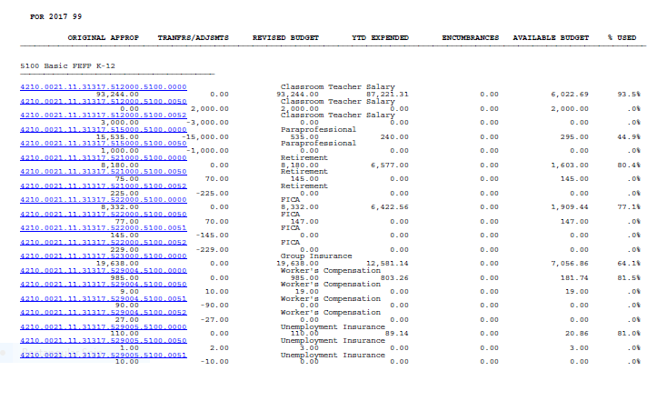
Title 1 Budget Report by Function without Journal Detail

Slide 15
Title 1 Budget Lines by Function & Group without Journal Details

Slide 16
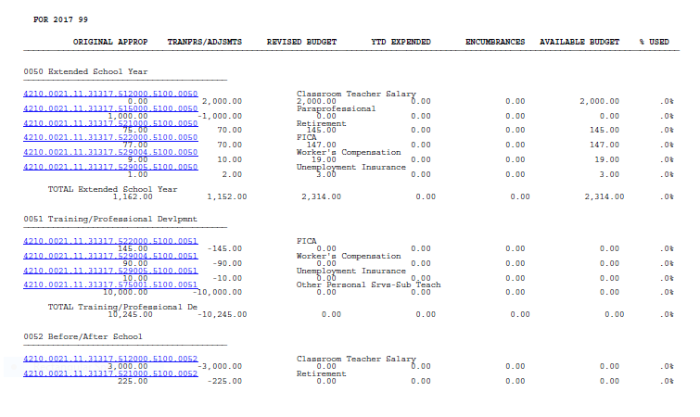
Title 1 Budget Report by Function and Group without Journal Detail

Slide 17
Title 1 Budget Lines by Object

Slide 18
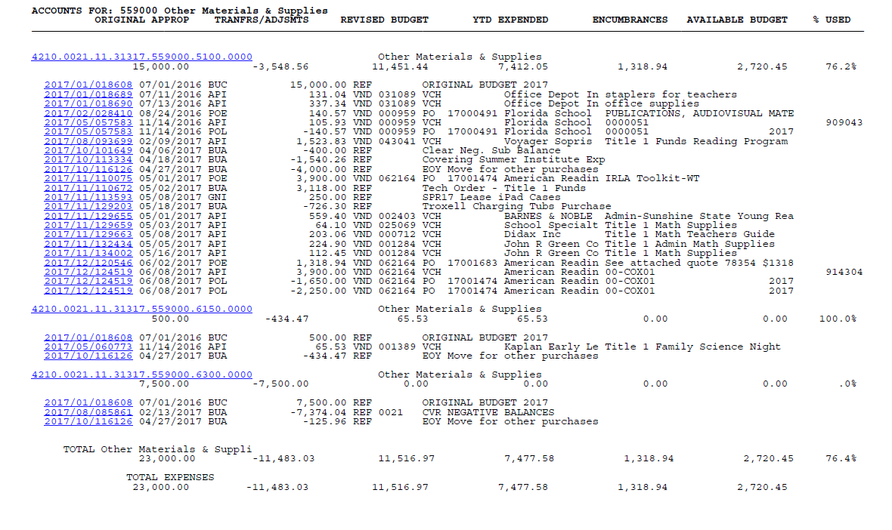
Title 1 Budget Report by Object with Journal Detail

Slide 19
Title 1 Salary Budgets Lines by Group

Slide 20
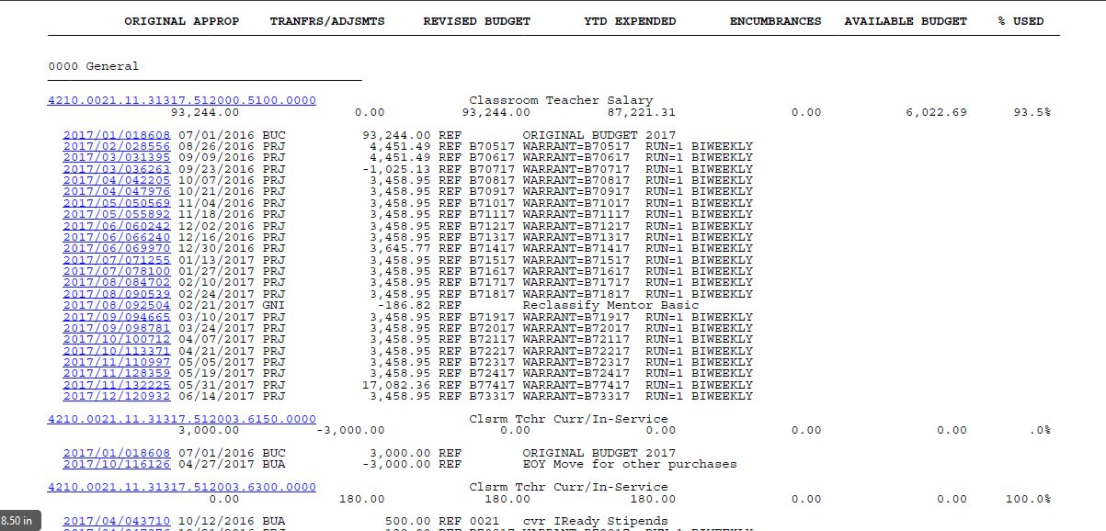
Title 1 Salary Budget Report by Group with Journal Detail

Slide 21
Title 1 Funds and Incentives
“Will this item improve student achievement?”

Slide 22
Ask yourself these three questions when buying student incentives
If you can answer these questions and provide supporting documentation, the incentive can be purchased.
Is this purchase reasonable? – Will I be able to justify this expense to an auditor?
Is this purchase educationally related? - Incentives should not only be educationally related, but designed to increase student achievement
Is this purchase nominal? -Incentives should be a small
portion of your overall budget

Slide 23
Title 1 Allowable & Not Allowable Expenses
Refer to the Title 1 Technical Assistance Guide handout
Refer to Examples of Allowable & Unallowable Title 1 Expenditures handout
Parent Involvement
Parent Workshops
Parent Award events, banquets
Guidelines for purchasing food
Gratuities, delivery charges and tips

Slide 24
Managing Supply, Salary, Substitute and Stipend Lines
0%
July 1, 2017
October
2017
December
2017
April
2018
June 30, 2018
20%
50%
75%
100%

Slide 25
Some Fun Facts
Title 1 Records need to be retained for 7 years – the Federal government can audit your school for up to seven years. Keep all Title 1 financial records as well as Parent Compacts boxed up and marked with a destruction date.
Before erasers it was common for people to erase pencil using crumbs from white bread.
Cows can produce 125 lbs. of saliva in one day!

