Slide 1

Volunteer/Employee Concession Training
2020-21

Slide 2
Basic Public Health Food Protection Practices
It is important that we follow the Florida Department of Health Food Code because:
  The Department of Health works with food service establishments as defined by Section 381.0072, Florida Statutes to help ensure their products are not a source of foodborne illness.
  For further information on codes and standards for food service establishments, please refer to: Chapter 64E-11, Florida Administrative Code.
  The Department of Health's (DOH) Food Hygiene Inspection Program is required to inspect concession stands when in operation. It is mandatory that all volunteers of concession stands receive annual training.
  Verification of this training MUST be kept in the establishment.
  Failure to provide proof of training and roster will be required to schedule testing and training and will be required to pay applicable fees.

Slide 3
Service personnel who prepare foods must be knowledgeable about safe methods of thawing, cooking, cooling, handling, holding, and storing foods.
Service personnel must be knowledgeable about safe methods of food service.
Service personnel who clean equipment and facilities must be knowledgeable about proper cleaning and sanitization methods.
Service personnel responsible for maintaining the premises must be knowledgeable about proper insect and vermin control methods.
Person in Charge must obtain and maintain an attendance roster of all employees present during training.
  Both the training curriculum and attendance roster must be maintained for three years and available upon request by the department.
  Establishments that are not compliant with the employee training requirements and record retention of this section must schedule a training and testing with the department and pay any applicable fees.

Slide 4
Information to Know
Each food operation must be issued its own individual sanitation certificate and must post their own sanitation certificate in a conspicuous location
Children under 14 years of age are not permitted in food preparation areas
Handwashing Facilities –
  At least one employee handwashing facility must be located within each food preparation area, within 20 feet of the duty station, visible and accessible through an unobstructed area.
  Where only prepackaged food items are served and workers do not open prepackaged items or otherwise come into contact with exposed food, a handwashing sink must be within 100 feet and on the same floor where food items are distributed.

Slide 5
Information to Know
Ice: Ensure scoops with handles are used to minimize contamination
Store ice scoops in a manner that prevents contamination
  Scoop should not be left in ice machine
  Scoop must be stored in a closed container and must be cleaned and sanitized as needed
A sanitizer solution in a bucket or spray bottle to adequately sanitize the food preparation surfaces must be available at all times.
All food service operations which prepare food on premises must provide an adequate supply of potable water for cleaning and employee handwashing.
An adequate supply may be provided in clean, portable containers equipped with on/off valves. Soap and single-service towels must be available for handwashing and hand drying.

Slide 6
Information to Know
All food service operations at temporary food service events without effective facilities for cleaning and sanitizing tableware must provide only single-service articles for use by the consumer.
Food Protection – A thermometer accurate to plus or minus 3 degrees Fahrenheit must be provided to indicate the air temperature of food storage compartments used for time/temperature control for safety foods
  Probe thermometers must be used to measure final temperature of cooked foods.
  All equipment will be sufficient and working properly:
    All refrigerators, freezers and warmers will have a working thermometer

Slide 7
Importance of good personal hygiene practices
Clean clothing must be worn
Never smoke, drink, eat or chew gum when prepping or serving food or working in prep areas.
DO NOT wear fingernail polish or artificial fingernails when working with exposed food unless wearing food service grade disposable gloves.
DO NOT work around food if you have experienced any of the following:
  Vomiting
  Diarrhea
  Sore throat with fever
  Jaundice (yellowing of skin and eyes)
  Wounds on the hands or arms
  Diagnosed foodborne illness
  Exposure to foodborne illness

Slide 8
Importance of good personal hygiene practices
DO NOT work while affected with any disease in a communicable form or while a carrier of such disease or while afflicted with boils, infected wounds, sores, or an acute respiratory infection, can work in any area of a food service establishment

Slide 9

How and when to properly wash hands

Slide 10

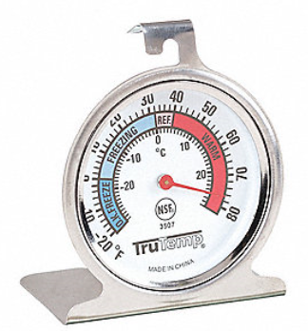
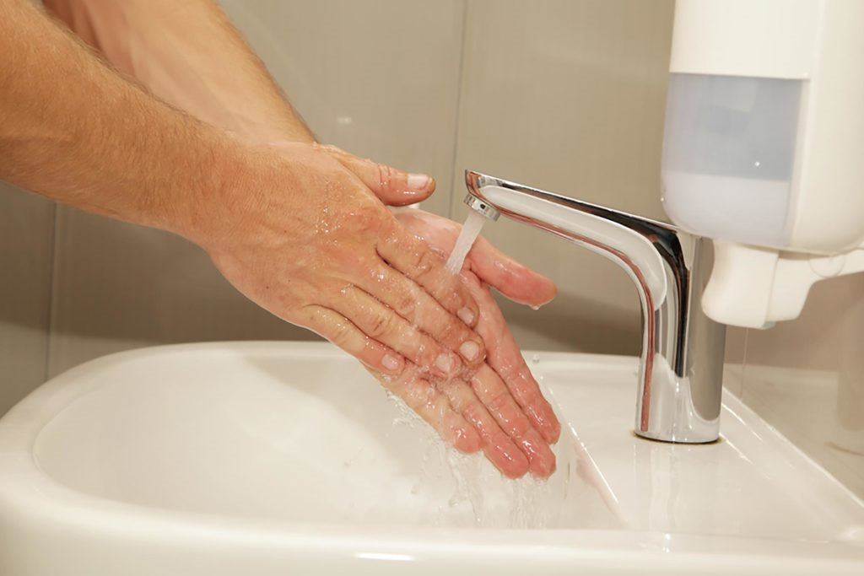
Ensure adequate supply of soap is provided at hand wash sink in concession stand.
Floors, walls, and ceilings shall be smooth and washable.
Adequate ventilation shall be provided.
Each refrigerator, freezer and warmer will have a working thermometer.

Slide 11

Jewelry and Hair Restraints
Remove jewelry from hands and arms before prepping food. A plain wedding band may be worn.
If possible, hair should be restrained with a hat or hair tie to prevent hair from falling into food

Slide 12
Food Service Personnel Responsibilities
Food Service Personnel know duties of their job
  It is imperative that anyone working/volunteering for concession adheres to all Health Codes outlined in this training
Safe Methods of thawing, cooking, cooling, handling, holding and storing foods
Proper cleaning and sanitizing methods for food service establishment
Maintaining equipment and establishment premises

Slide 13
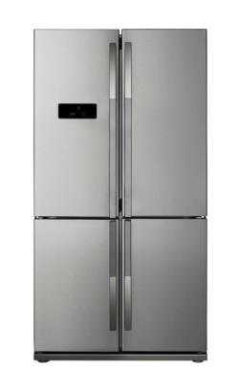
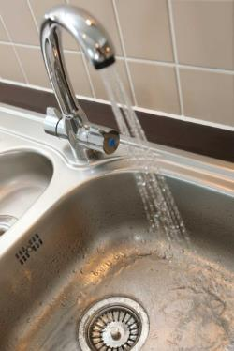
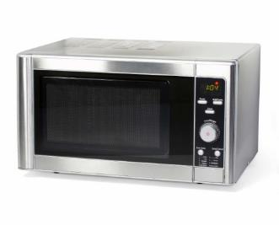
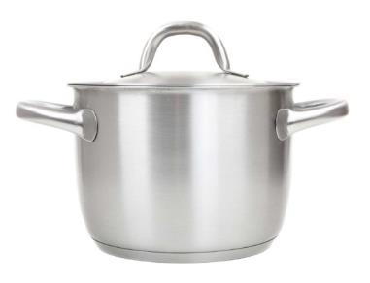
Thawing
BEST: In a refrigerator, at 41°F or lower keeping the food out of the Temperature Danger Zone
Submerged under running
potable water, at a temperature
of 70°F or lower
In a microwave oven, if the food will be cooked immediately after thawing
As part of the cooking
process

Slide 14
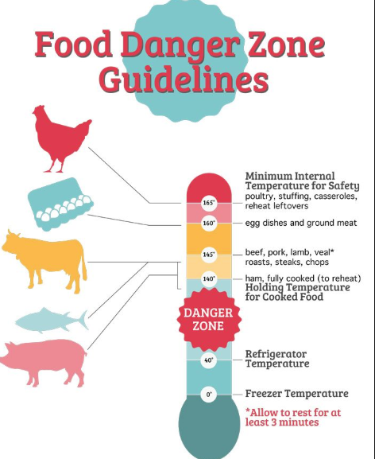
Cooking
Cook foods to the correct internal temperature
Temperature Danger Zone:
  140 degrees F - 41 degrees
  If food falls within this range, must be reheated to 165 degrees F
Notes:
Temp taker cheat sheet

Slide 15
Cooling
The FDA recommends that food be cooled from 140°F to 41°F in six hours or less.
This time limit helps prevent dangerous bacteria growth.
Food must be cooled from 140°F to 70°F
in two hours or less.
In this range, bacteria can double in as little as 20 minutes. The sooner food passes through this temperature range, the better.
This entire cooling process is often called the two-stage cooling process.

Slide 16

Handling
Hold cold food at or below 41 °F
Prepare cold food in small batches
Pre-chill shelf stable foods prior to preparation
Use gloves for all ready to eat foods to prevent contamination
Keep raw food separate from cooked foods
Notes:
Tuna in refrig
Ice packs during prep

Slide 17
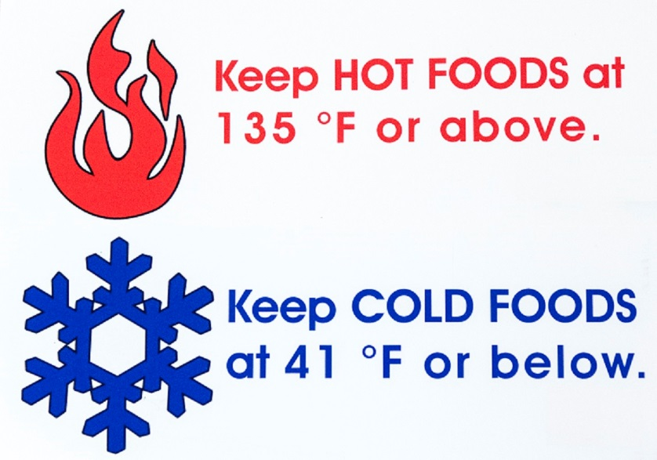
Holding and Serving
140
Notes:
Marrying foods
Changing utensils with each new batch

Slide 18
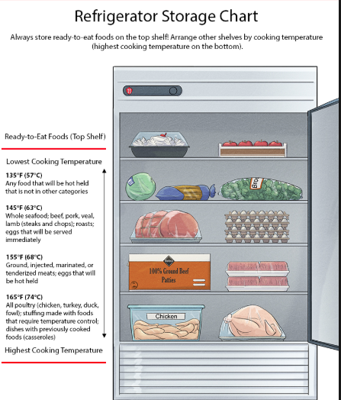
Storing
Dry storage: 76 °F or less
Refrigerator: 41 °F or below
Freezer: at or below 0 °F
6” off Floor
12” from ceiling
Store chemicals in a manner that prevents contamination
  All chemicals must be stored separately from food

Slide 19
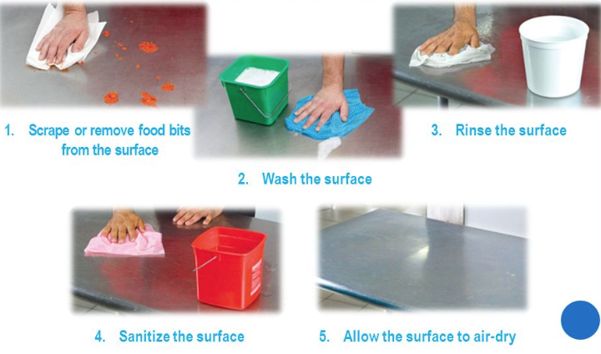
Cleaning, Rinsing, and Sanitizing

Slide 20
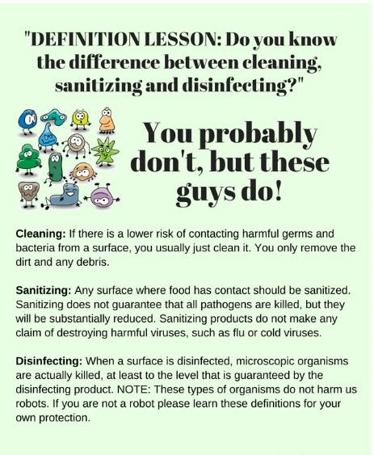

Slide 21
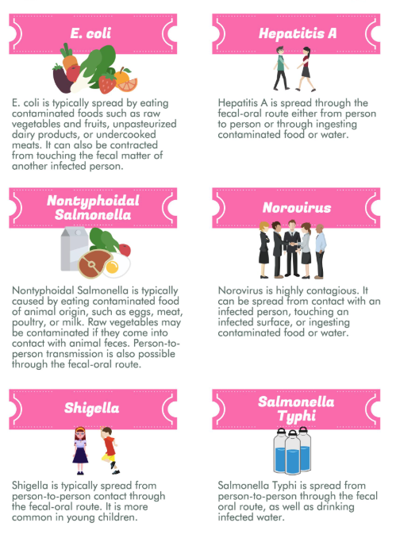
The Big “6”

Slide 22
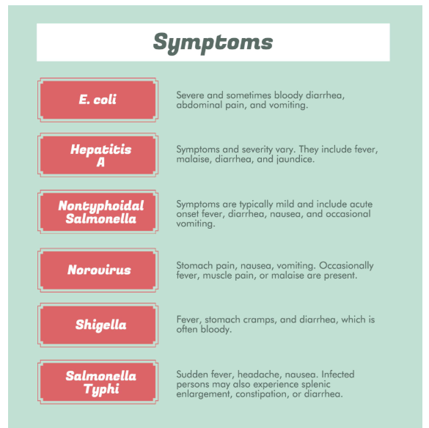
The Big “6”

Slide 23
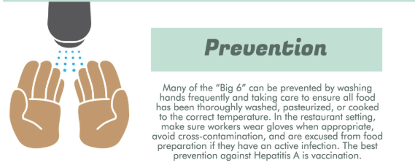
The Big “6”

Slide 24
Maintaining equipment and establishment premises
Maintain food equipment in a clean and sanitized manner.
  Ensure equipment is maintained clean and sanitized.
  Buffet foods shall be displayed and served to minimize contamination.
  Clean plates shall be made available to customers.
  Dispensing utensils shall be used to avoid unnecessary manual contact and stored properly.
All food service operations at temporary food service events without effective facilities for cleaning and sanitizing tableware must provide only single-service articles for use by the consumer.

Slide 25
Proper Insect and Pest Control
Deny Shelter
  Throw out garbage quickly and correctly
  Keep outdoor containers covered
  Clean up spills around containers and wash regularly
  Keep food away from walls and at least 6 inches off the floor
  Clean up spills and food spills immediately
Deny access
  Check food when delivered
  Make sure all vents are replaced when damaged
  Seal cracks in floors, walls and around pipes
  Inspect for dead insects and dispose of properly. Clean and sanitize appropriately
  Work with a Pest Control Operator if a problem persists

Slide 26
COVID 19 Procedures
Self-Screening must be performed and reported to Business Manager, Athletic Director and School Administrator prior to travel to competition venue if they are displaying symptoms related to COVID-19.
Masks are required at all times while working in the concession stand
Gloves are required at all times while working in the concession stand.

Slide 27
Thank you for completing the training! Please notify the Athletic Director or Volunteer Coordinator at your school that you have completed this compliance presentation.

