Slide 1
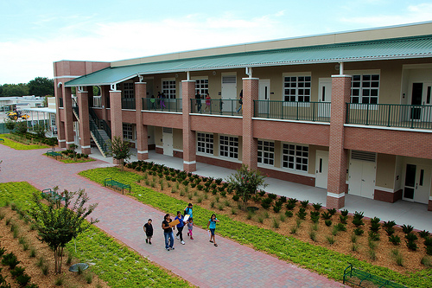
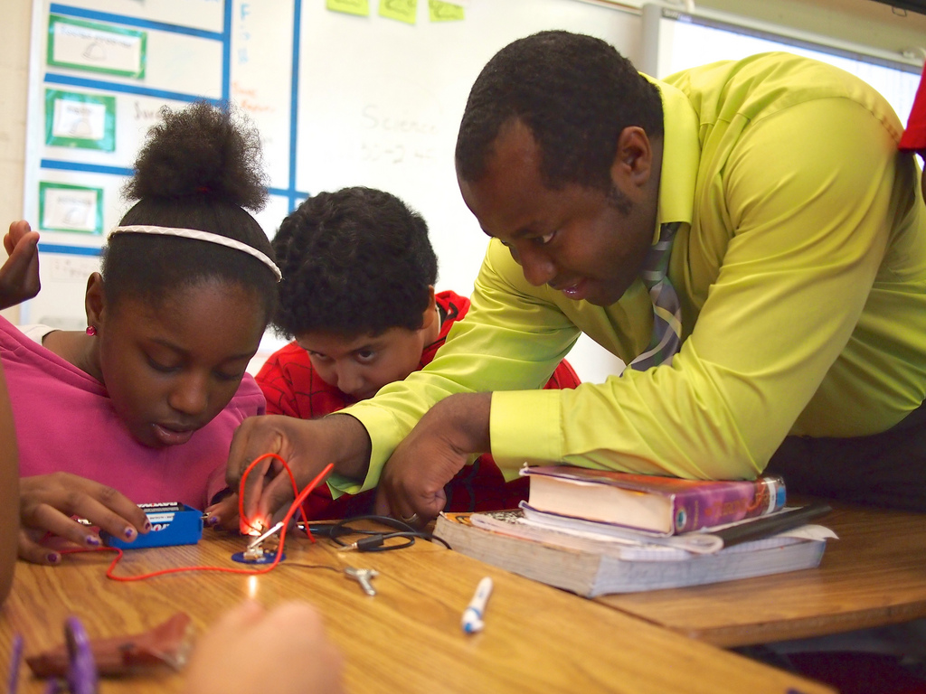
Safeguard Cash and Assets on Campus
Tips to Prevent and/or Spot Theft by “Insiders”
Leadership Week – June 9-12, 2015

Slide 2
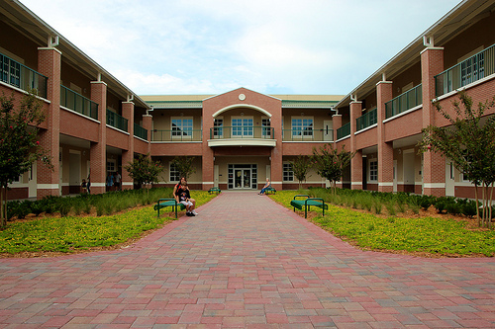
Overview
Safeguard cash and property items
Recognize potential theft by individuals who
have access to school funds

Slide 3
Safeguard Cash
Encourage the use of School Pay
Use safes for any cash left in school overnight
If your school does not have a safe in or near the bookkeeper’s area, please contact Ray Bonti
Use a bank courier service
Teachers should not leave collections in their classrooms overnight.
If they are not “done” with the collection documents, put them in an envelope and put in the safe for overnight
Checks are important too! Checks can be easily copied and deposited electronically. We need to safeguard other people’s checks in our custody.

Slide 4
Safeguard Other Assets.1
Make sure that Property Items are tagged
Make sure items are tagged immediately
Include secondary marking – permanent marker etc
Tags are usually sent a week or so after the items are delivered to the school
Tags are sent to the school by Property Control (Finance). Usually to the bookkeeper.
Items costing $750 or more must be tagged – let Property Control know of any that are not tagged
All iPads and tablets must be tagged regardless of cost
Make sure that items get the right tag – check serial numbers.
Use permanent marker to add tag # and Pasco Schools
OTIS will be tagging iPads and computers received through the leasing agreement
Notes:
1) Property Control has been sending the tags to both the ICT Literacy Coach and Plant Manager. Just recently, it was changed and they will now be sending tags to the bookkeeper because tags were getting lost or tags would be filed away and never affixed to the inventory item. Just wanted to mention that this step is a change to the prior procedure.
2) Also, please mention that if an item is being loaned to another school (band instrument, maintenance equipment, etc.) a checkout form should be completed.
3) There should also be a record or work order (with the tag number) for items taken off campus for repair.

Slide 5
Safeguard Other Assets.2
Make sure that Property Items are tagged (cont’d)
Property Items obtained by other sources must be reported to Property Control so that tags can be issued
Purchased through Internal Accounts
Received by Donation
Obtained through DonorsChoose etc
Equipment Check Out
Make sure that any equipment that is leaving the campus is properly checked out
MIS 192 sent out by Communications on 5/28/15
Teachers – computers, iPads
Students – computers, iPads, musical instruments

Slide 6
Tips to Prevent and/or Spot Theft by “Insiders”.1
Lots of People have access to money at your schools
We tend to concentrate on the bookkeeper but she can only control the money that is submitted to her
The real risk is at the point that the money is actually collected (concessions, fund raisers, ticket sales etc)
Internal Groups
Make sure that you know what your teams, clubs and coaches are doing!
All groups should be completing fund raising applications and recaps
Pay attention to the people around you. If people think there is something wrong, there is probably something wrong!

Slide 7
Tips to Prevent and/or Spot Theft by “Insiders”.2
Outside Groups
Outside groups must complete support organization agreement and budget
Make sure the budget is detailed enough that you know what they are doing. Concessions, fund raisers, fees directly from parents, parking…
Outside group must have only one bank account
Bank statements must be mailed directly to the school.
Someone at the school must open and review
Look for odd items, cash withdrawals, checks with one signature
Outside group must submit quarterly financial statements and annual audit with supporting documentation
These should be submitted on a timely basis. If they make excuses or avoid submitting documents there is probably something wrong!!
Pay attention to the people around you. If people think there is something wrong, there is probably something wrong!
Notes:
Check signer should not be on audit committee
May add fundraisers if money is ”short”

Slide 8
Questions and Comments

